Slide 1
CARE Application
GOAL SETTING

Slide 2
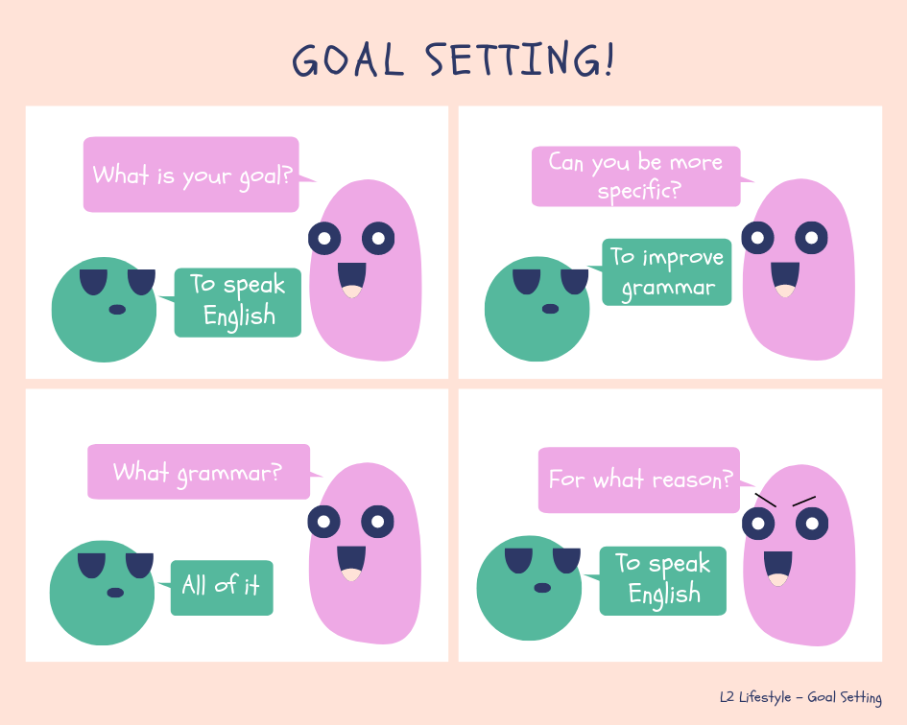
CARE – Application
Module – GOAL SETTING

Slide 3
CARE – Application
Module – GOAL SETTING
The aim of this topic is to highlight the importance of goal setting in the learning process
Objectives:
- Distinguish types of goals,
- Show how to set goals,
- Show how to use them in the classroom.

Slide 4
CARE – Application
Module – GOAL SETTING
Content
1. Introduction,
2. Purpose of goal setting,
3. SMART goals,
4. How to set goals,
6. Goals in the classroom,
7. Activities,
8. Group discussion.

Slide 5
CARE – Application
Module – GOAL SETTING
Why do we set the goals?
IN PAIRS: discuss for what reasons your students need goals.
Notes:
maximum 5 minutes

Slide 6
CARE – Application
Module – GOAL SETTING
Why do we set the goals?
To decide what you want to achieve in your course
To separate what's important from what's irrelevant, or a distraction
To motivate yourself
To build your self-confidence, based on successful achievement of goals
Gives a structure to your course
It keeps you focused
Awareness of possibilities
Etc.

Slide 7
CARE – Application
Module – GOAL SETTING
GAP
A GAP is the distance between where you are right now and where your goal is
If there’s no GAP, there’s no effective learning process
Student’s need to identify their GAP
The goal is usually outside of their “comfort zone”

Slide 8
CARE – Application
Module – GOAL SETTING
COMFORT ZONE
COMFORTABLE or CONFORMIST?
Our comfort zone protects us from possible dangers from the unknown (outside of the comfort zone)
To prevent us from going out of the comfort zone, our brain surrounds it with “limiting beliefs”

Slide 9
CARE – Application
Module – GOAL SETTING
What are your students’ goals?
IN PAIRS: discuss for what your students’ goals might be.
Notes:
maximum 5 minutes

Slide 10
CARE – Application
Module – GOAL SETTING
S M A R T

Slide 11
CARE – Application
Module – GOAL SETTING
Specific / Significant
What exactly do they want to achieve? The more specific they are, the better chance they’ll have of achieving their goal.
Many students say “I want to improve my English level” whereas they should be trying to break it down to a more specific goal such as “I want to focus on my speaking and be able to do everything on the ‘can do’ list for spoken interaction by August .

Slide 12
CARE – Application
Module – GOAL SETTING
Questions students may ask themselves when setting goals and objectives are:
What exactly do I want to achieve?
Where? – In my classes, home, etc.
How? –Focusing in class and reviewing/practicing at home.
When? – One hour each evening
With whom? – Friends.
What are the conditions and limitations? – If I am working / going on a trip with friends, I will make that hour up during the week.
Why exactly do I want to reach this goal? What are possible alternative ways of achieving the same? To communicate more fluently with clients in work. Alternative way would be to take private lessons to focus on this goal (one goal at a time).

Slide 13
CARE – Application
Module – GOAL SETTING
Measurable / Meaningful
They need to break it down into measurable elements so they can identify what they will see when they reach their goal.
For example: objective results, fewer errors etc.

Slide 14
CARE – Application
Module – GOAL SETTING
Attainable / Adjustable
Need to figure out if their goal is attainable and consider if it is really worth the effort.
Need to consider all the factors (time, effort, cost, etc.) and measure them with their personal /professional obligations. If its attainable, then they must commit to it 100%.
If they don’t have the time, money and or commitment, it doesn’t mean they CANT achieve something they want. They just have to adjust their plan a bit and go for it!

Slide 15
CARE – Application
Module – GOAL SETTING
Relevant / Responsible
Is reaching their goal relevant to them? Do they actually want to reach C1 level, or do they need to? Maybe they’ll find that reaching a B2+ level would suffice in finding the job they want. Get them to ask themselves these questions:
Why do you want to reach this goal? What is the objective behind the goal? Will this goal really achieve that?

Slide 16
CARE – Application
Module – GOAL SETTING
Timely
Making “deadlines” for their goals can really motivate the students and get them in “action mode”.
Should encourage students to:
Plan deadlines – Make sure the timeline is realistic and flexible
Commit to them
Remind them to inform the teacher of their plan
Monitor them to give them some “extra motivation”
Most importantly, make sure they are enjoying what they are doing and not being too hard on themselves, it can really lower their spirits.

Slide 17
CARE – Application
Module – GOAL SETTING
How do we set them?
State each goal as a positive statement – Express your goals positively – "Execute this technique well" is a much better goal than "Don't make this stupid mistake.“
Be precise – Set precise goals, putting in dates, times and amounts so that you can measure achievement. If you do this, you'll know exactly when you have achieved the goal, and can take complete satisfaction from having achieved it.

Slide 18
CARE – Application
Module – GOAL SETTING
Set priorities – When you have several goals, give each a priority. This helps you to avoid feeling overwhelmed by having too many goals, and helps to direct your attention to the most important ones.
Write goals down – This makes them clear and gives them more power.

Slide 19
CARE – Application
Module – GOAL SETTING
Keep operational goals small – Keep the low-level goals that you're working towards small and achievable. If a goal is too large, then it can seem that you are not making progress towards it. Keeping goals small and incremental gives more opportunities for reward.

Slide 20
CARE – Application
Module – GOAL SETTING
Set performance goals, not outcome goals – You should take care to set goals over which you have as much control as possible. It can be quite discouraging to fail to achieve a personal goal for reasons beyond your control!
In business, these reasons could be bad business environments or unexpected effects of government policy. In sport, they could include poor judging, bad weather, injury, or just plain bad luck.
What might be an obstacle in language learning?

Slide 21
CARE – Application
Module – GOAL SETTING
Set realistic goals – It's important to set goals that you can achieve. All sorts of people (for example, employers, parents, media, or society) can set unrealistic goals for you. They will often do this in ignorance of your own desires and ambitions.
It's also possible to set goals that are too difficult because you might not appreciate either the obstacles in the way, or understand quite how much skill you need to develop to achieve a particular level of performance.

Slide 22
CARE – Application
Module – GOAL SETTING
Goal setting in the classroom
Guide students into setting goals for themselves.
Prompt the students when guiding them.
Encourage students to come up with only one or two goals at a time. It will depend on the student and their wants and needs, without being too overwhelming.
Set specific goals that they will be able to accomplish. For example, if your student wanted to be able to read 150 words per minute by the end of two weeks, this may be an unreasonable task. You can guide them into determining how many weeks would be a reasonable goal to accomplish their task, such as six weeks.

Slide 23
CARE – Application
Module – GOAL SETTING
Teach Students to Create a Plan
What can you do to achieve your goals?
What can you do at home? In school?
What strategies do think will help you?

Slide 24
CARE – Application
Module – GOAL SETTING
Create a Goal-Tracking System Together
Create a tracking system to help them get their goals. It might be controlled daily or weekly depending on the goal and the time. It should also be completed by the student, and only the student. It should be created together with the student and the teacher, and not all tracking systems will be the same for everyone. It might be a digital tracking system, hand-written, or paper one.

Slide 25
CARE – Application
Module - XXXXXXXXX
Celebrate!
If the students have met what they set out to do, it should be celebrated.
As long as you are celebrating the success of the goal, then it doesn’t matter how you do it. – Brainstorming
Remember
You are the guide in this process not the instructor. You guide students into making their own decisions and taking ownership of their own learning. If take over, you are defeating the purpose of the process.

Slide 26
Disclaimer: The Publication has been produced with the support of the Erasmus + Programme of the European Union. The contents of this page are the sole responsibility of partners and can in no way be taken to reflect the views of the NA and the Commission.
http://www.l2lifestyle.eu/
https://www.facebook.com/l2lifestyle

